Slide 1
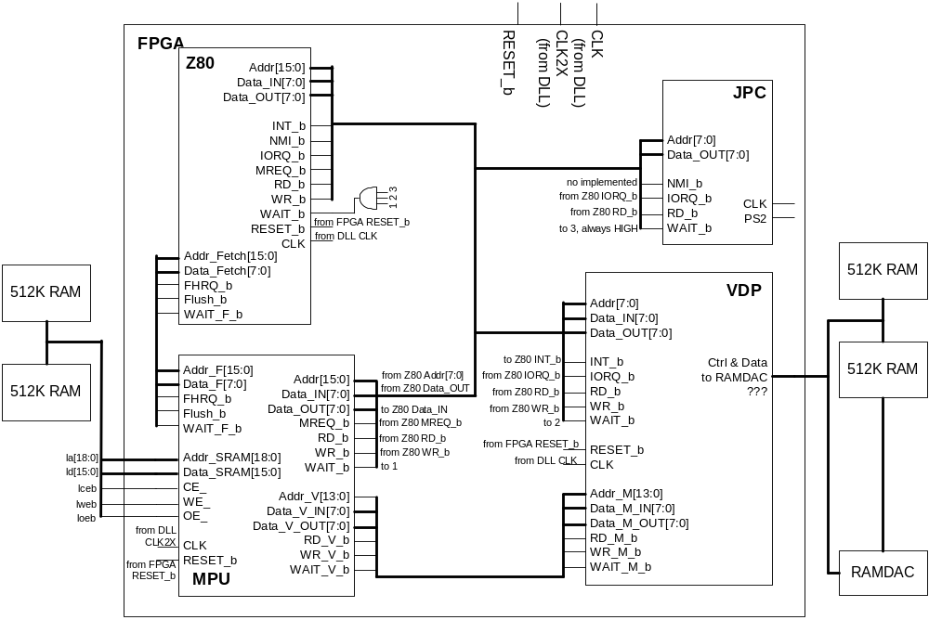
System I/O
Notes:
Devices introduction
Memory Configuration and Double clocking.
2 sets of buses, CPU<->MPU and VDP<->MPU
Interrupt INT and NMI
WAIT signal

Slide 2
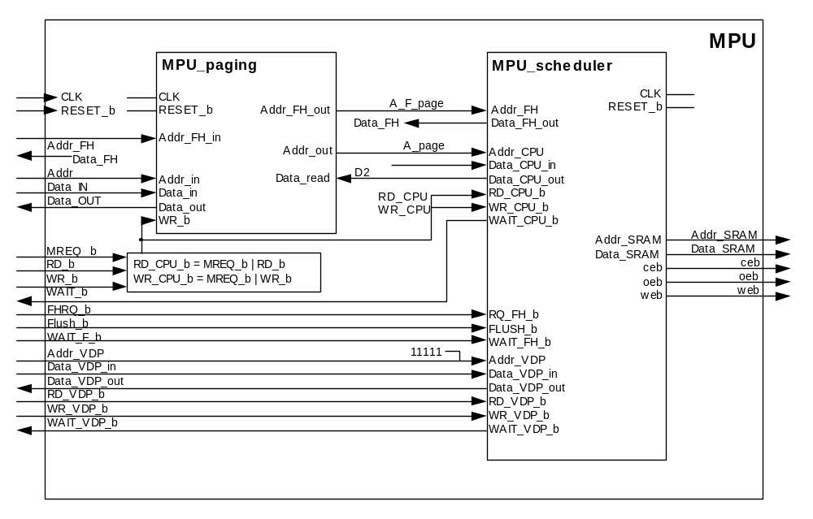
MPU (Memory Paging Unit)
5 MSB
0xxxxx (256K) SMS ROM
1xxxx (256K-last 54K) SMS Battery-Backed-Up RAM
11101 (16K) User RAM
11110 (4 bits) FCR (FFFC~FFFF)
11111 (16K) VDP Memory

Slide 3
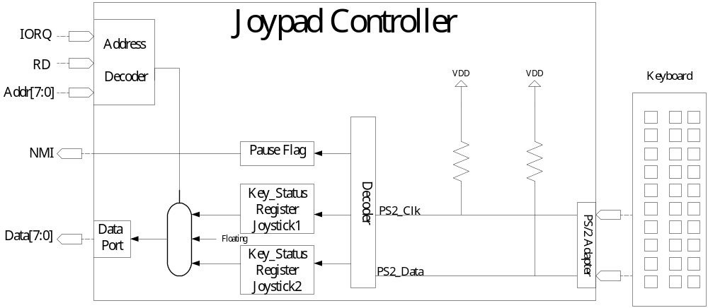
Joypad Controller (JPC Unit)

Slide 4
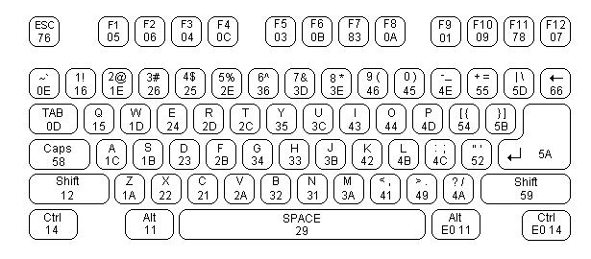
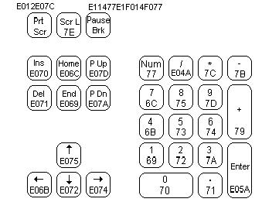
Joypad to Keyboard Mapping
 |  | Up | Down | Left | Right | FireA | FireB
Joy1 | Mapping Key | Ｗ | Ｓ | Ａ | Ｄ | < , | > .
 | Scan Code | 1D | 1B | 1C | 23 | 41 | 49
Joy2 | Mapping Key | ↑ | ↓ | ← | → | 0 Ins | . Del
 | Scan Code | E075 | E072 | E068 | E074 | 70 | 71

Slide 5
SMS Emulator
Z80 version
  Download the framework from web
  Reconstruct the Z80 CPU
Z80 Decoder
Z80 Core
VDP ( )
MPU ( )
JPC ( )
Memory ( )
SYS_IO ( )
Z80 CPU

Slide 6
SMS Emulator (Contd.)
Uop translator version
  Map the Verilog Translator to C++ code
  Implement the micro instruction set
Z80 Decoder
Z80 Core
VDP ( )
MPU ( )
JPC ( )
Memory ( )
SYS_IO ( )
Micro_I
Translator
RISC CPU

Slide 7
Miscellanea
Disassembler and profiler
  Z80 instruction decoder
  Every instruction is used
Debugging tools
  Virtual VDP and MEM
  Software interface with SPART
    With the range of Baud Rate: 9600 - 115200
  Bus traffic generator for VDP debugging
  Bus traffic playback based VDP

